Slide 1

An Examination

Slide 2
The Five Tenets of the Mega Church:
Enlargement
Ecumenicalism
Emotionalism
Entertainment
Empathy
Michal Hardin, “The Blueprint for Mega-churches.” The Bible And Contemporary Churches, edited by Mike Willis.
Guardian of Truth Foundation, 2005, pp. 60-63.

Slide 3
“In reaction to the pitfalls of denominations, the mid-20th century birthed the baby boomer phenomenon of the “nondenominational megachurch.” American evangelicalism saw a rising tide of churches that were explicitly or implicitly anti-doctrinal and nontraditional, focused on relevance, extraversion, positivity, attractional style and seeker-sensitivity. Often these churches are helmed by a charismatic male head-pastor.”
Warner, Tish, “Willow Creek’s Crash Show Why Denominations Still Matter,” www.religionnews.com/2019/03/25/willow-creeks-crash-shows-why-denominations-still-matter/

Slide 4
The Community Church
(mega church operation)
has been developing over the past several decades
has sprung up in almost every area of the country
growth is exceedingly fast
often attracts local and national media

Slide 5
Questions About the Mega Church Operation
what led to the emergence of the mega church operation?
what tactics are used to propel the movement?
is it a sound movement?
what effect does it have on churches of Christ

Slide 6
Founder
Donald McGavran born in India 1897
  after completing college in US he returned to India in 1923
  disturbed at slow growth
  studied 145 missions over 17 yrs.
  published his research in “The Bridges of God” (1955)…his basic conclusions:
    church needs to embrace what actually produces disciples
    effective evangelism will produce numerical results

Slide 7
Some Foremost Leaders of the
Church Growth Movement
Bill Hybels, Willow Creek Community Church, South Barrington, Illinois
  Recently laden with scandal and mass departure (2018)
Rick Warren of Saddleback Community Church, Lake Forest, California

Slide 8
Some Good Components of the C.G.M.
pressing prayer
  1 Thess. 5:17
high premium on leadership

Slide 9
Some Good Components of the C.G.M.
Strive for excellency in worship
  conveys seriousness
  however, CGM stresses on giving people what they “want” rather than what they “need”
  what do visitors think when they visit?
  what does God want?

Slide 10
Some Good Components of the C.G.M.
integrating new converts into the work and life of the church
  members should have close relationships
  Acts 2:44-47

Slide 11
Some Good Components of the C.G.M.
keep up the physical surroundings of the building
  classrooms
  landscape
  professional look
  would my home or business be suitable if it is in the same shape as the house of prayer (Hag. 1:3-11)?

Slide 12
The Dangers of the Church Growth Movement
Satan’s Sweet Subtleties

Slide 13
Dangers
letting the world set the agenda for the church
  giving the world what it wants
  Romans 12:2
giving special attention to selected Scripture that deals with growth while neglecting other teachings

Slide 14
Dangers
tremendous emphasis on what the audience THINKS as relevant, “the audience, not the message is sovereign”
(George Barna, Marketing The Church)
“In fact, it is possible to be so relevant that one becomes irrelevant because you are merely telling people what they already know, and not what they need to hear”
-Kirk Wellum, An Evaluation of the Church Growth Movement

Slide 15
Dangers
whatever “works” is “right”
  success is not always measured numerically (i.e., Noah, 1 Pet. 3:20; 2 Pet. 2:5)
  what is “right” is what “works” in eternity
  “growth for growth’s sake is cancer”

Slide 16
Dangers
be a “user-friendly” church
  the gospel has bad news for those who will not conform (2 Cor. 2:14-17)
  There are two qualities in preaching: love and a rod (1 Cor. 4:21)
  sorrow and an unwelcoming attitude can often exist due to sin (2 Cor. 12:20 – 13:2)
  was the early church “user-friendly”
  (Acts 5:1-11)?

Slide 17
Dangers
overemphasis on “perking” attendance and catering to the unbelieving visitor
  we ought to be concerned with the unbeliever who enters but not for his agenda for the church (1 Cor. 14:23-25)
    cannot go beyond Scripture (1 Cor. 4:6)
  the early church did not “perk” attendance by having drama acts, light shows, and staging wrestling matches

Slide 18
Why the Emergence of Community Churches?
a rejection of the “establishment” and “traditional” church services
  “At Last! A new church for those who’ve given up on traditional church services.”
    Rick Warren, The Purpose Driven Church

Slide 19
Why the Emergence of Community Churches?
a rejection of the “establishment” and “traditional” church services
  “Thirty years ago, we were in a movie theater and thought it was so cool because we were finally delivered from the horrors of stained glass and wooden pews.” –Billy Hybels

Slide 20
Anti-traditional
Rick Warren’s tradition is to be against traditional worship
  traditions of men that conflict with God’s word must be rejected (Matt. 15:3)
  traditions in culture that that do not conflict with God’s word should be regarded (Acts 24:16; 1 Cor. 9:19-23; 10:32, 33; Rom. 13:7)
  traditions from the apostles must be reverenced

Slide 21
Apostolic Tradition
“But we command you, brethren, in the name of our Lord Jesus Christ that you withdraw from every brother who walks disorderly and not according to the tradition which he received from us”
(2 Thess. 3:6)

Slide 22
Why the Emergence of Community Churches?
downward spiral of denominational churches
  “The growth comes as overall church attendance has slipped nearly 20 percent in the past 10 years, according to Barna research, a polling firm that focuses on religious issues. Barna says 40 percent of the nation goes to church on a typical Sunday, down from 49 percent in 1991”
  (God on a Grand Scale, Mega-Churches Grow Bigger and Bigger,
  Oliver Libaw, abcnews.com)

Slide 23
Denominational Downward Spiral
Compromise
as denominations decline in membership, they begin to compromise to sustain numbers
extending fellowship to homosexuals; condoning abortion; etc. has turned off many
mega churches usually have a higher moral message than mainstream denominationalism in key areas
membership
& morality

Slide 24
Tactics of the Community Church
a strong dynamic leader
  parallels the beginning of mainstream denominational churches

Slide 25
Dynamic Personalities of Denominational Churches
Martin Luther
John Calvin
John Wesley
Joseph Smith
William Miller
Lutheran 1530
Presbyterian 1535
Methodist 1729
Mormon 1830
Adventist 1831

Slide 26
Tactics of the Community Church
adopt a neutral name
  names that suggests no denominational ties
  often obsessed with “community”
    Saddleback Community Church
    Willow Creek Community Church

Slide 27
Tactics of the Community Church
adopt a neutral name
  “It’s become common among some Protestants — and especially evangelicals — to call themselves ‘Jesus followers.’ Not Christians. Not Baptists or Pentecostals. Not members of the Presbyterian Church in America or the Anglican Communion. Not Wesleyans or Methodists or Lutherans. Just people following Jesus.”
  Are they following Jesus? Acts 11:26; 26:28; 1 Pet. 4:16
    Or the pastor of the church?

Slide 28
Tactics of the Community Church
adopt a neutral name
  the motive is to hide identity, to be less offensive, not a return to the Bible “to speak where the Bible speaks”
  when building a new facility, do a name change
    i.e. “Little Flock Baptist Church” to “Little Flock Ministry Center” (Shepherdsville, KY)

Slide 29
Tactics of the Community Church
“Attraction Evangelism”
  grew out of denominational concept of chicken dinners, ball teams, etc.
  attractions in Mega Churches are simply bigger

Slide 30
Mega Church
Mega Attractions
“large outreach events. . .contemporary Christian concerts, creative presentations that utilize drama, multimedia, and the arts. . .men’s breakfasts, women’s luncheons, leader’s dinners”
(Bill Hybels, Becoming A Contagious Christian, pp. 207, 208)

Slide 31
Mega Church
Mega Attractions
“Mega-churches also often have a virtually complete social environment, featuring sports and recreation facilities such as basketball courts, pools, or roller-skating rinks. Some have movie theaters and retirement homes built into their complexes”
  (God on a Grand Scale, Mega-Churches Grow Bigger and Bigger,
  Oliver Libaw, abcnews.com)

Slide 32
Mega Church
Mega Attractions
“The list of activities can sound like the offerings at a Club Med or a small liberal arts college: poetry workshops, creative writing, singles groups, job fairs, vocational training, musical lessons, and even auto repair clinics. ”
  (God on a Grand Scale, Mega-Churches Grow Bigger and Bigger,
  Oliver Libaw, abcnews.com)

Slide 33
Mega Church
Mega Attractions
“For reverend James Meeks who is planning to convert 23 acres of vacant land at 115th & the Bishop Ford expressway, into a $40-million dollar complex…for 10-thousand parishioners to worship in on Wednesday and Sunday. And for all of the surrounding community to enjoy the rest of the week, with plays, concerts, lectures, and sports activities. Made possible by removing the convertible seats. There will be three regulation basketball courts with the main court being in the center, and we would build a 500-seat hockey arena that will also have an indoor track…”
  (Andy Shaw, ABC7Chicago.com)

Slide 34
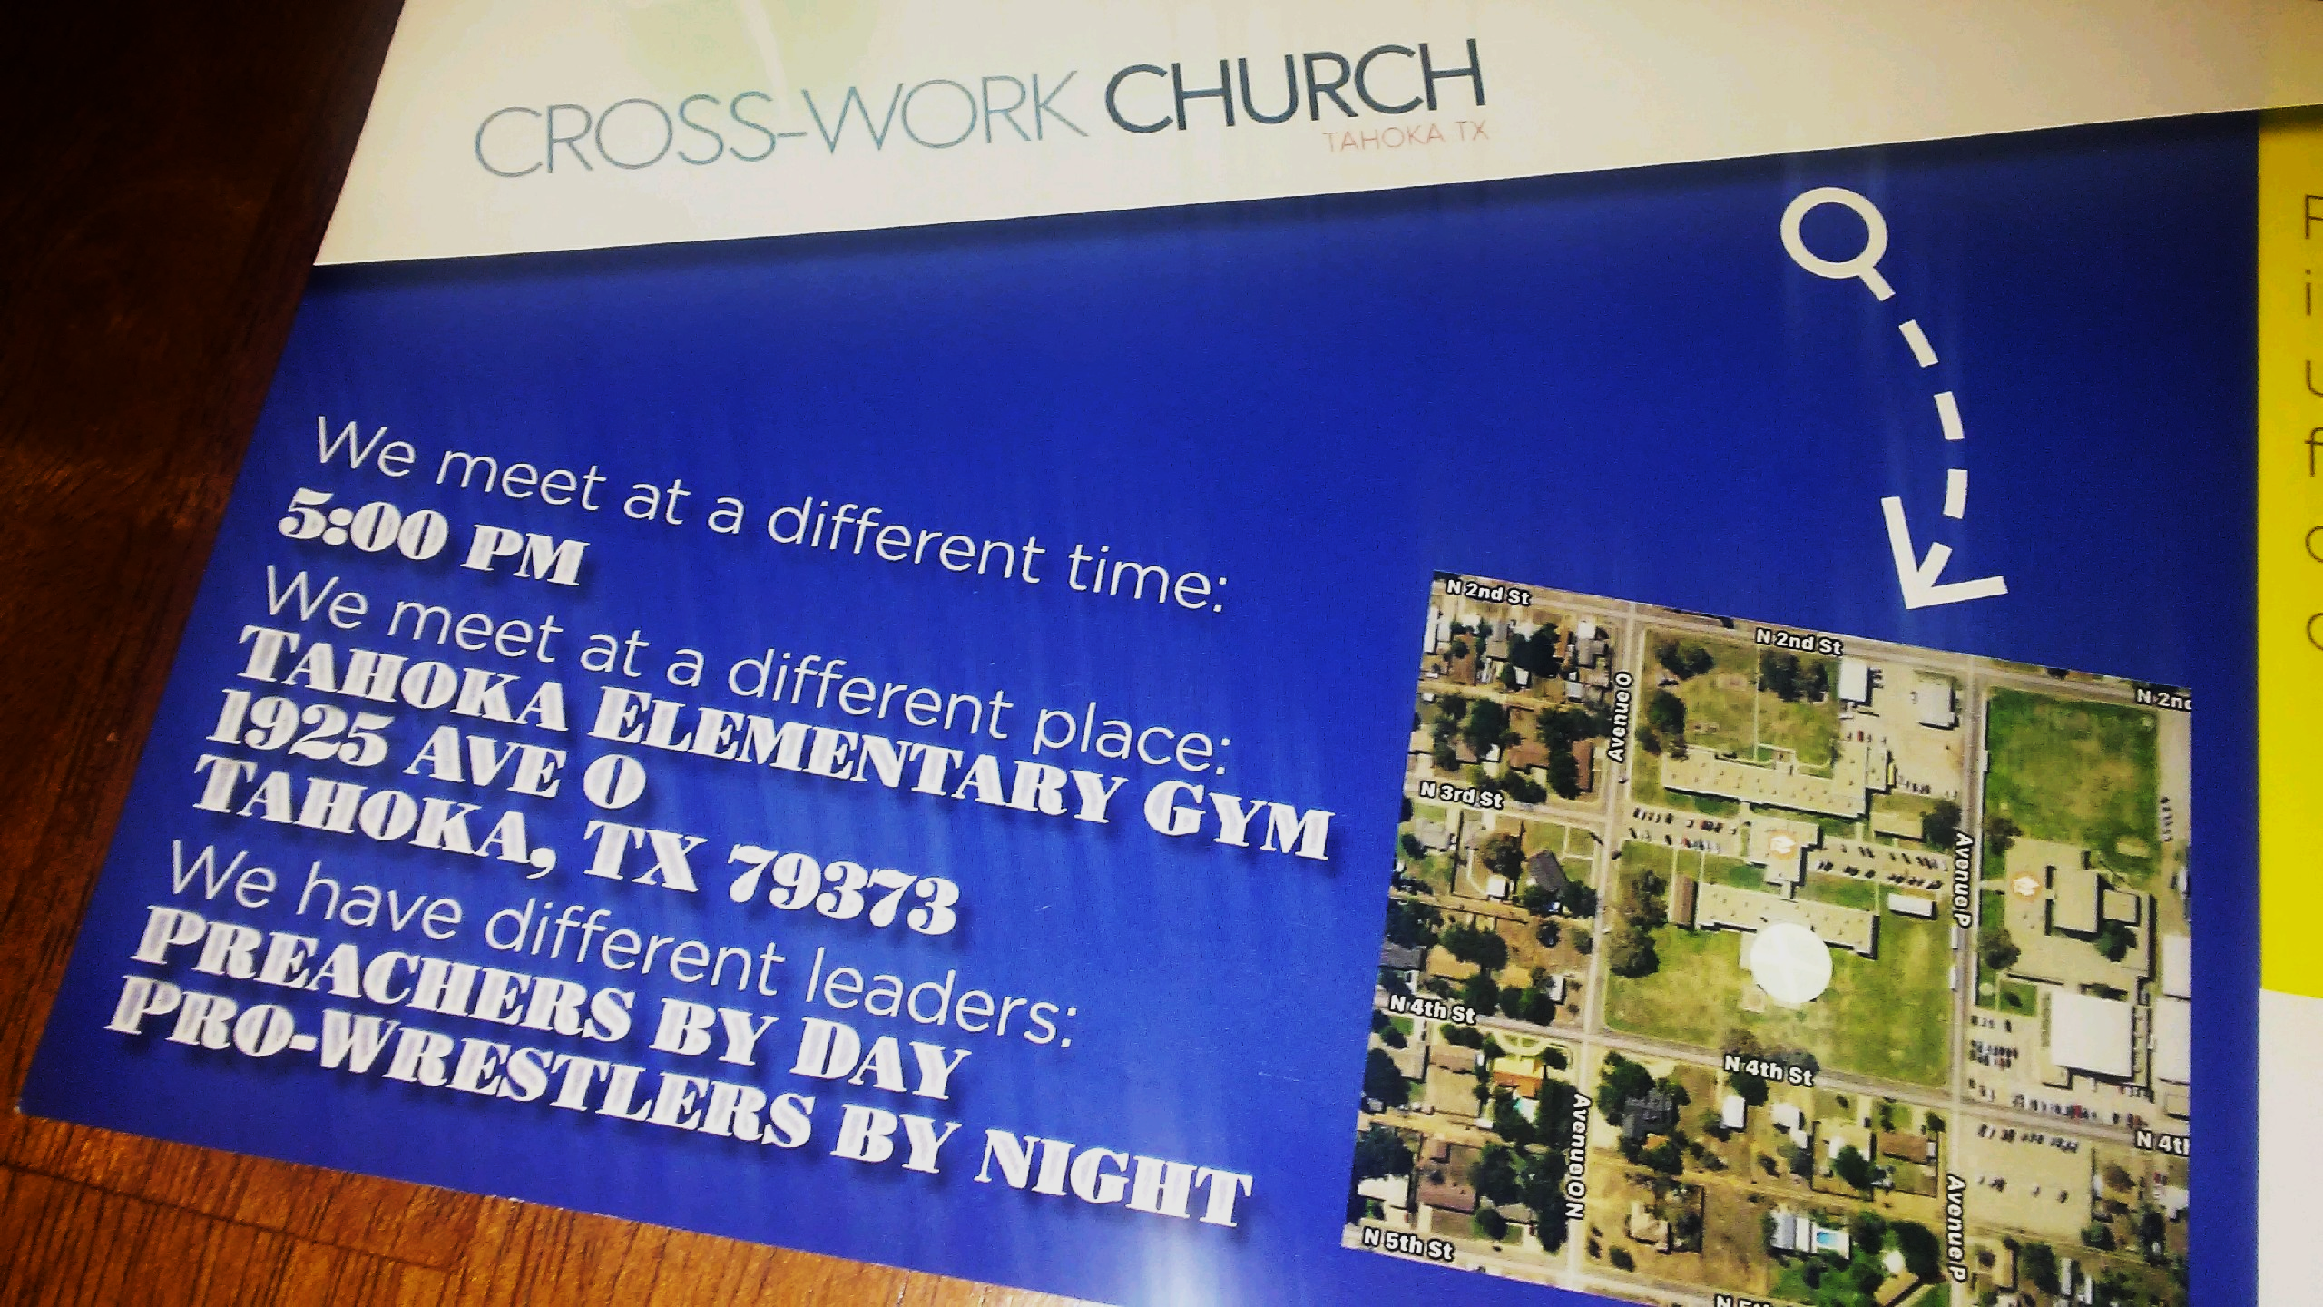
Worldly Attractions Often Appeal To Something “Different”

Slide 35
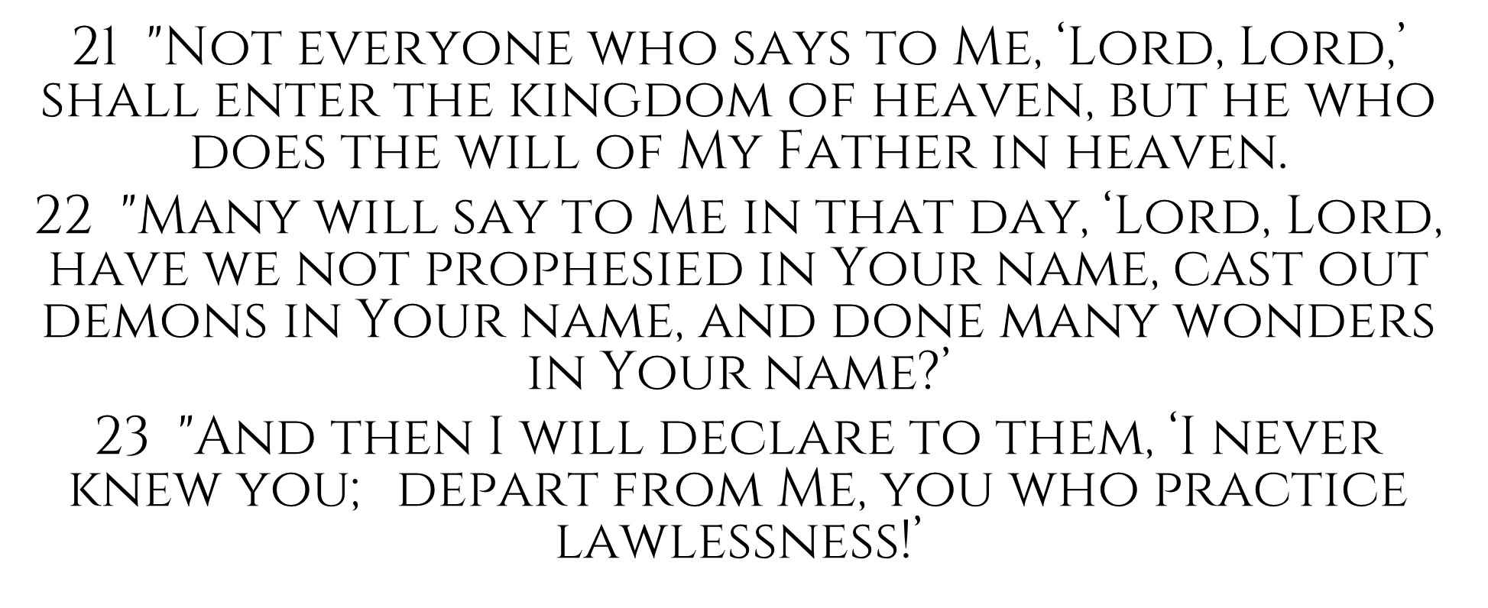
Matthew 7

Slide 36
What They Didn’t Know
What is the MAJOR factor for why people attend a place of worship?
A March, 2017 GALLUP POLL revealed a very important component of what drives people to worship and regular attendance

Slide 37
The MAJOR FACTORS For Adults Who Attend A Church Monthly or More:
John 6:26, “Jesus answered them and said, ‘Most assuredly, I say to you, you seek Me, not because you saw the signs, but because you ate of the loaves and were filled.’ ”
Sermons or talks that teach you more about scripture
Sermons or lectures that help you connect religion to your own life
Spiritual programs geared toward children and teenagers
Lots of community outreach and volunteer opportunities
Dynamic religious leaders who are interesting and inspiring
Social activities that allow you to get to know people in your community
A good choir, praise band, cantors or other spiritual music
76%
75%
64%
59%
54%
49%
38%
Source: https://news.gallup.com/poll/1690/religion.aspx, accessed, April 25, 2019.

Slide 38
The Cross—God’s Attraction for Evangelism
“And I, if I am lifted up from the earth, will draw all peoples to Myself. This He said, signifying by what death He would die” (Jn. 12:32, 33)

